Slide 1
Security Constrained Optimal Power Flow PowerModelsACDCsecurityconstrained.jl
Ghulam Mohy ud din
Early Research Career Fellow

Slide 2
Outline
Security Constrained AC-DC Optimal Power Flow (SCOPF)
Exact Formulation
Soft Formulation
Robust Formulation
Test Case 67 node AC-DC Power System
Results - Exact Formulation

Slide 3
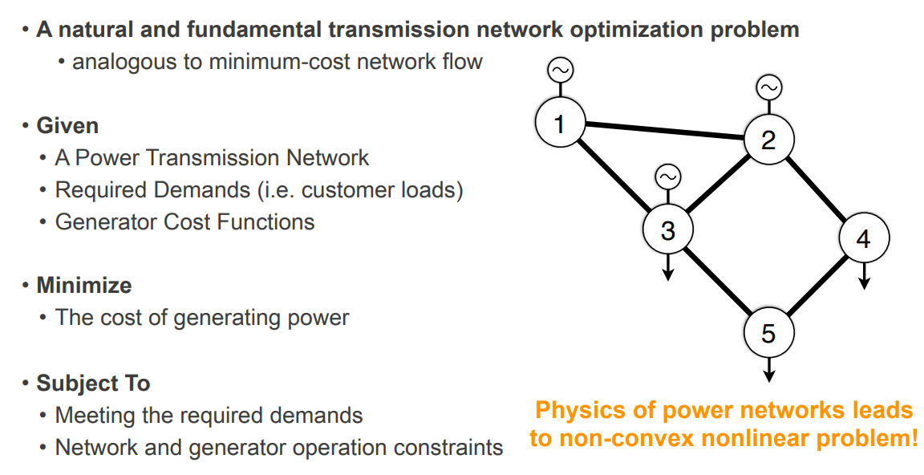
Optimal Power Flow (OPF)

Slide 4
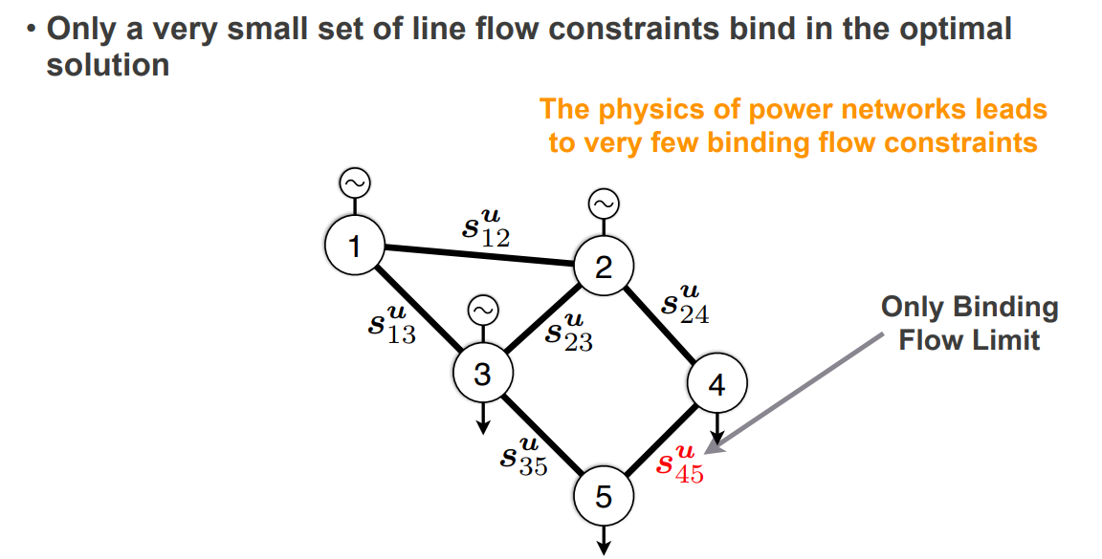
Key Point in OPF

Slide 5

Security Constrained Optimal Power Flow (SCOPF)
According to “Power System Security Guidelines and System Strength Requirements Methodology ” from AEMO:
Power Networks are regulated to be “N-1 Secure”
Intention, the network can withstand the spontaneous failure of any single component during daily operations
Details in practice
Focus on a specific subset of component failures
Many constraints can be exceeded for a short amount of time
What is the time scale? (1s, vs 1 min, 5min)
Available recourse actions?

Slide 6
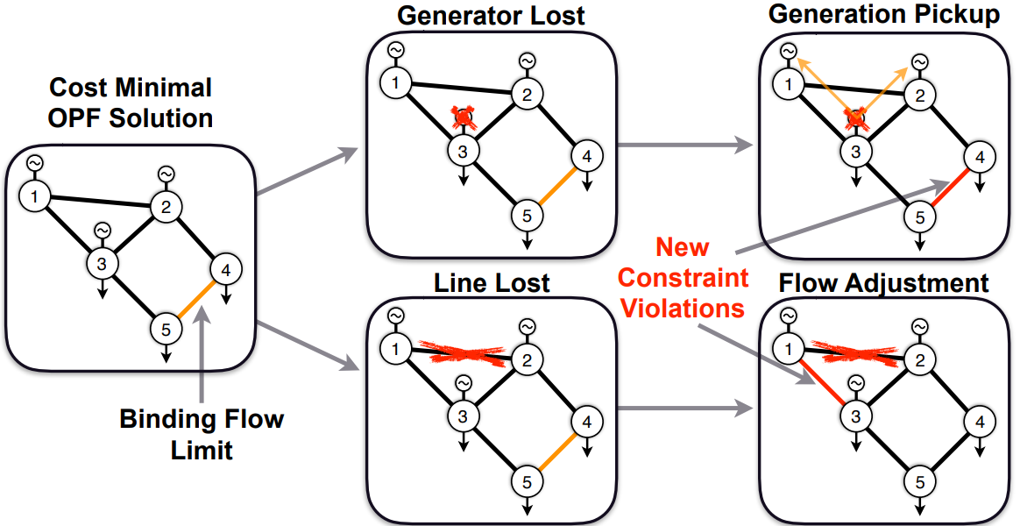
The Core Challenge of Security Constraints
→ How to solve the base case OPF problem subject to the contingency cases?

Slide 7
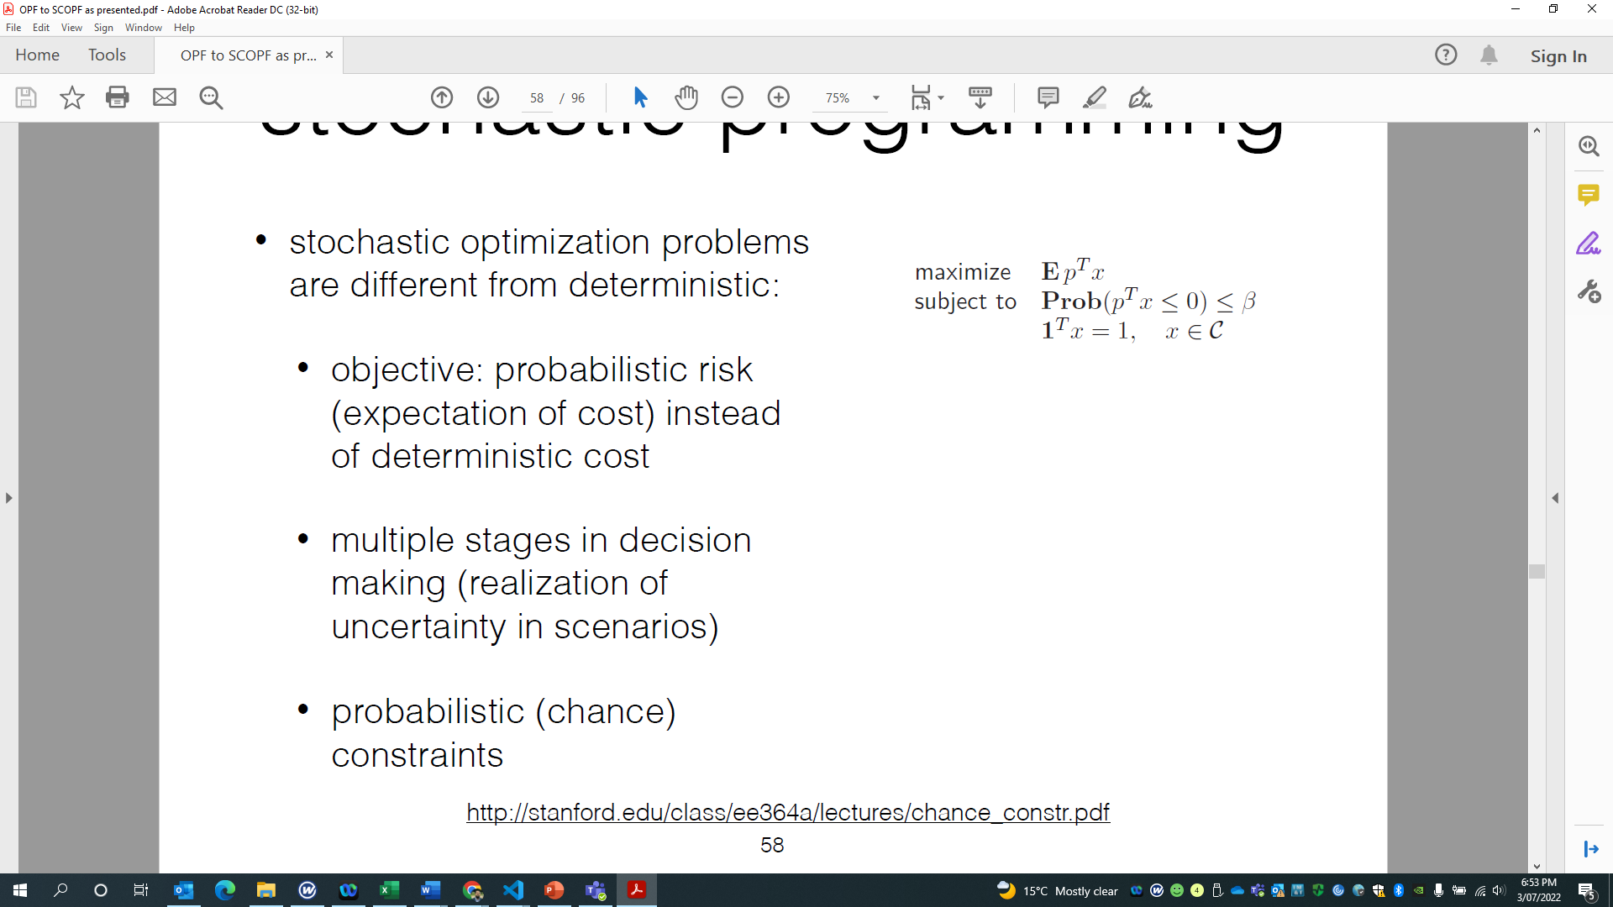
Stochastic Programming (SP)

Slide 8
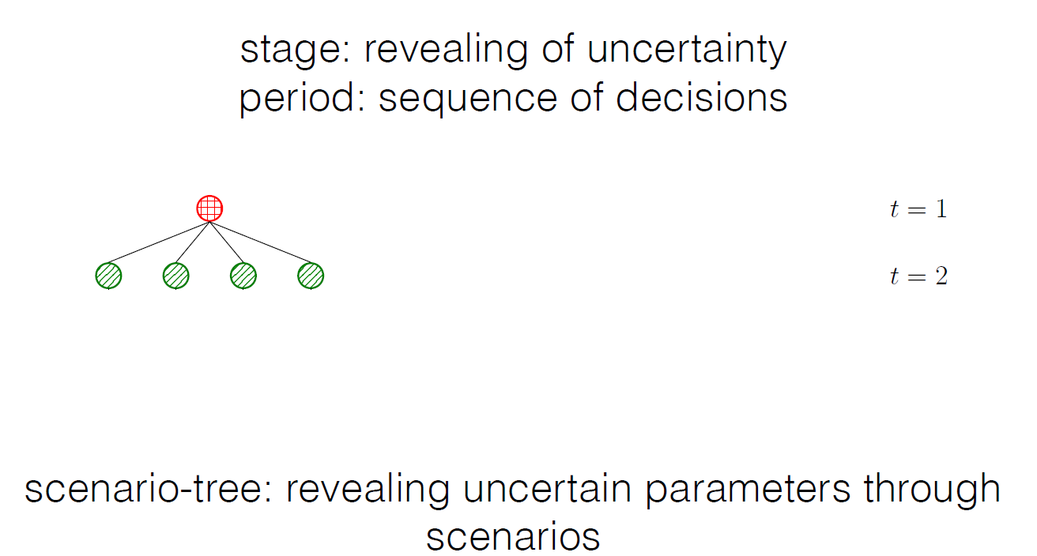
Two Stage – Two Period SP
First stage
Single period
Second stage
Multi period

Slide 9
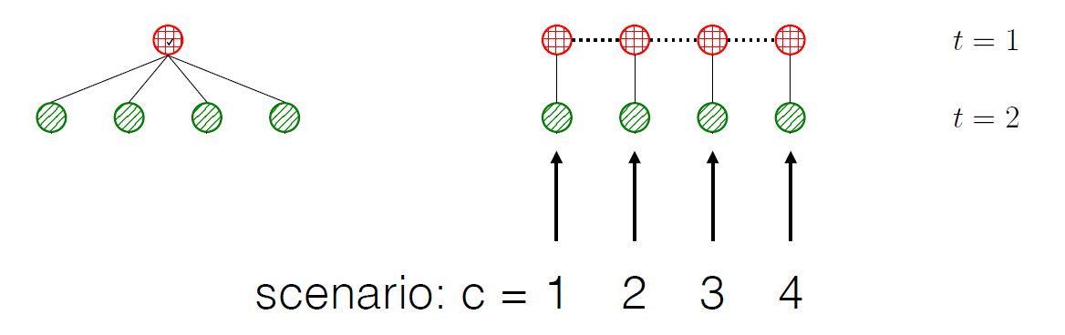
Two Stage – Two Period SP

Slide 10
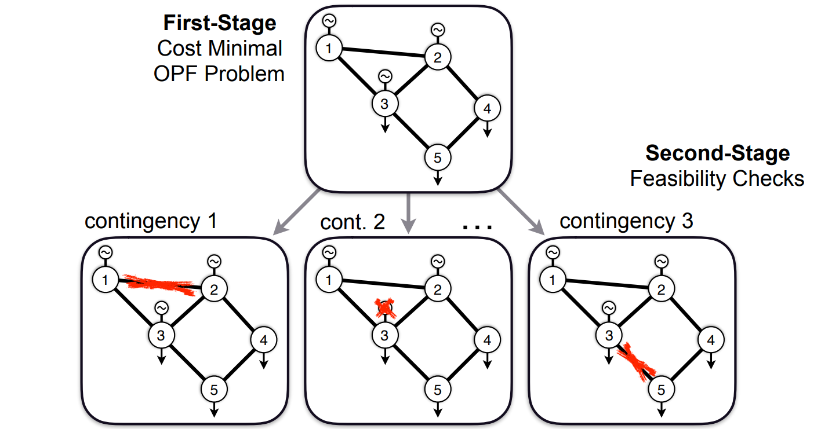
Two-Stage SCOPF
Single period
Multi period

Slide 11
Contingency Filters
Rank the generator, branch, and branchdc contingencies and down selects based on evaluation limits
Check a given operating point against the contingencies to look for violations. The unbounded ACDC Power Flow is used for the simulation
Return a list of contingencies where a violation is found
Base Case
(ACDC OPF)
Initial Operating Point
Sets of Contingencies by Ranks
(ACDC PF)
Violations
Contingency Cuts

Slide 12
Corrective and Preventive SCOPF (PSCOPF)
In a correctively secure system, any post-contingency constraint violation can be removed by suitable remedial actions
In a preventive secure system, without any remedial action, none of the probable contingencies causes constraint violation, The results clearly indicate the system operation state can be changed from a given operation point to a PSCOPF satisfied operation point by exerting beforehand control actions in specified number

Slide 13
ACDC SCOPF Algorithm
Base Case
(ACDC OPF)
Initial Operating Point
Iterations
Set of Contingencies
Contingencies Filter
(ACDC PF)
Violations
ACDC-SCOPF (Multiperiod ACDCOPF with Response Constraints)
Base Case
Contingency 1 Case
Contingency n Case
Solution

Slide 14
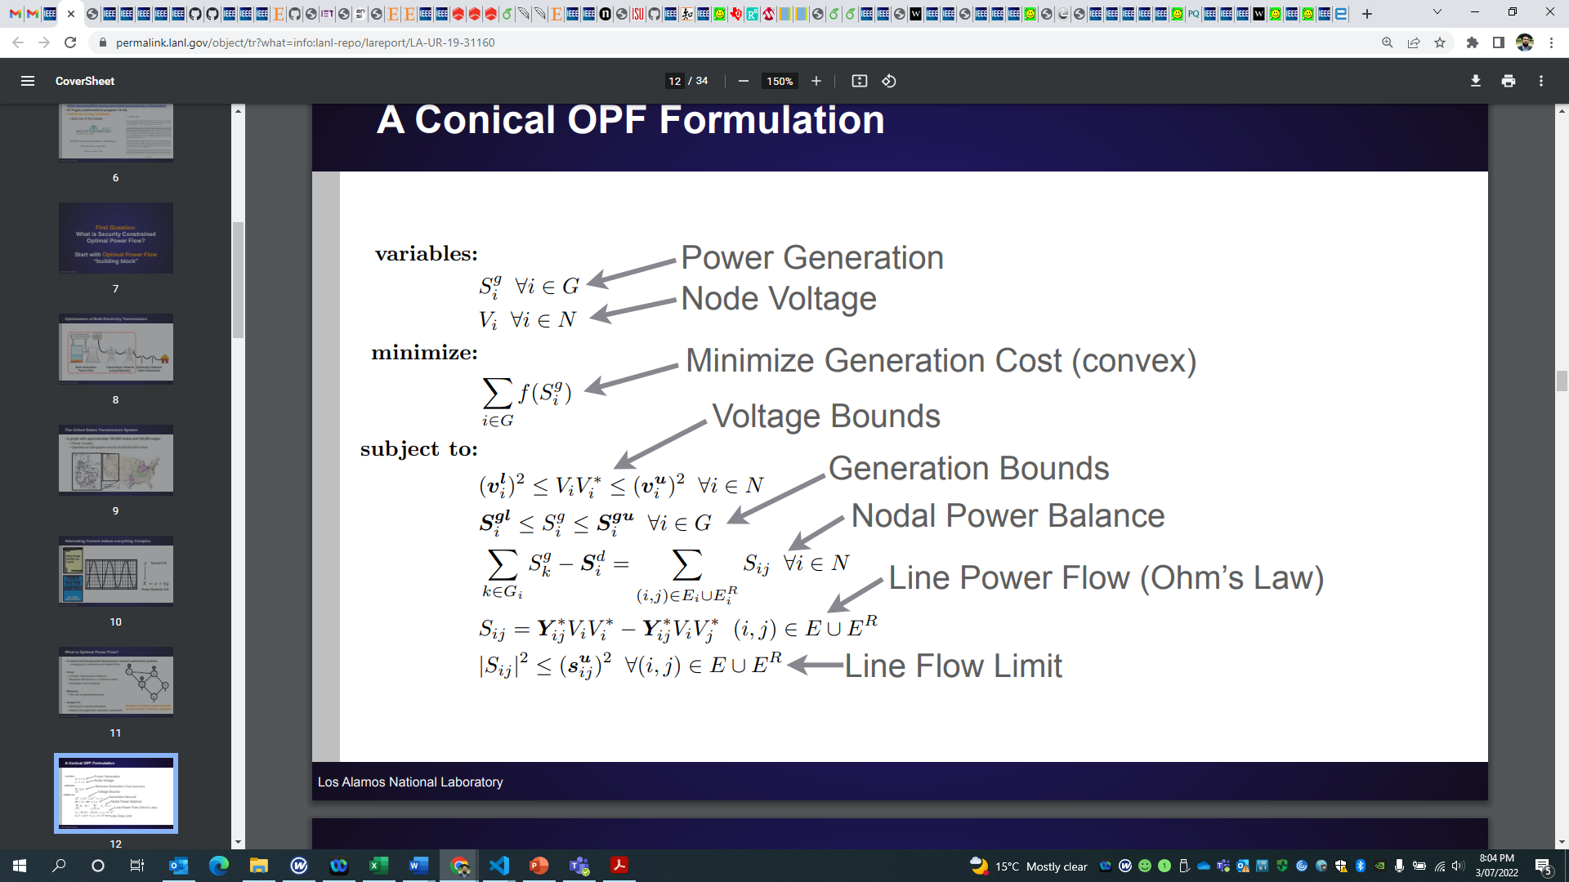
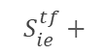
First-Stage Formulation (AC-DC OPF)
$$S_{ie}^{tf}+$$

Slide 15
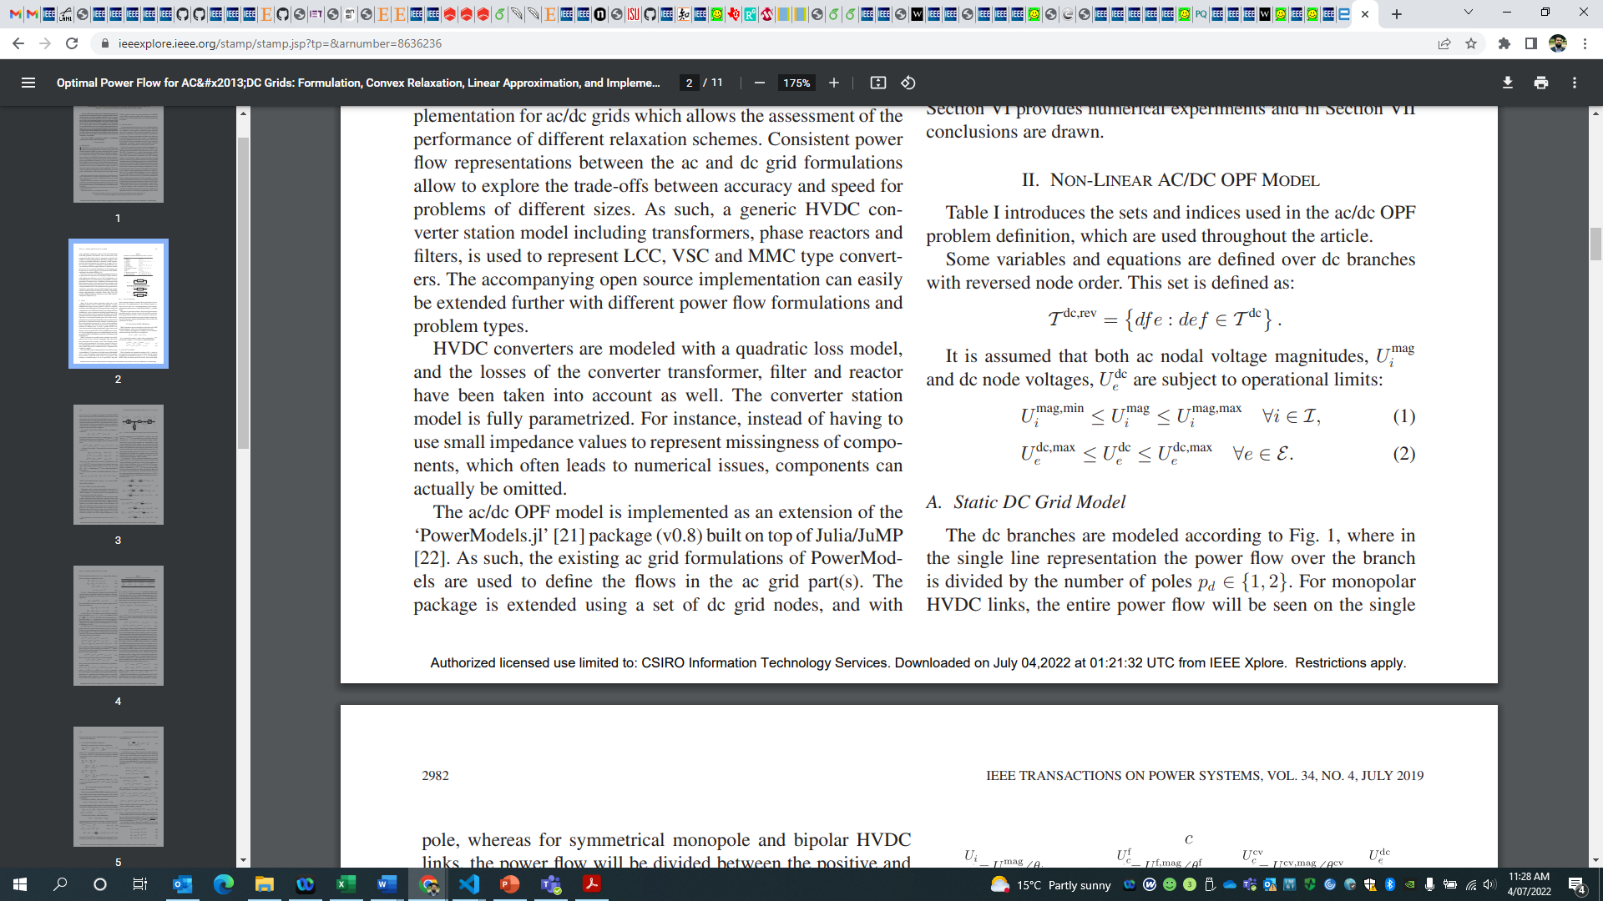
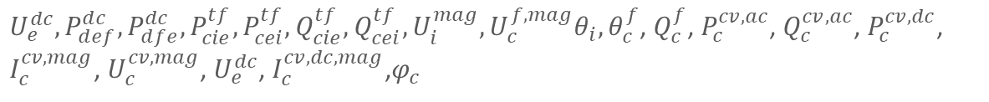
First-Stage Formulation (OPF)
Variables:
$U_{e}^{dc},P_{def}^{dc},P_{dfe}^{dc},P_{cie}^{tf},P_{cei}^{tf},Q_{cie}^{tf},Q_{cei}^{tf},U_{i}^{mag},U_{c}^{f,mag}θ_{i},θ_{c}^{f}$, $Q_{c}^{f}$, $P_{c}^{cv,ac}$, $Q_{c}^{cv,ac}$, $P_{c}^{cv,dc}$, $I_{c}^{cv,mag}$, $U_{c}^{cv,mag}$, $U_{e}^{dc}$, $I_{c}^{cv,dc,mag}$,$φ_{c}$
Subject to:
Node Voltage
DC Branch Flow
Power Flow Converter Transformer

Slide 16
First-Stage Formulation (OPF)
Filter Reactive Power
Nodal balance B/w filter, phase reactor, xformer
Converter Active /Reactive Power
Converter DC side Power
Converter loss model
Converter AC side Current and Voltage

Slide 17
First-Stage Formulation (OPF)
Converter DC side Current and Voltage
Firing angle of Thyristors for LCC converters
DC Power Balance

Slide 18
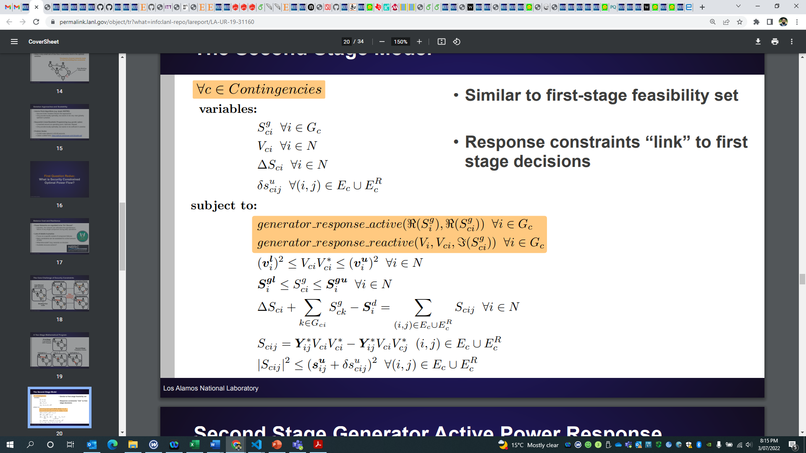
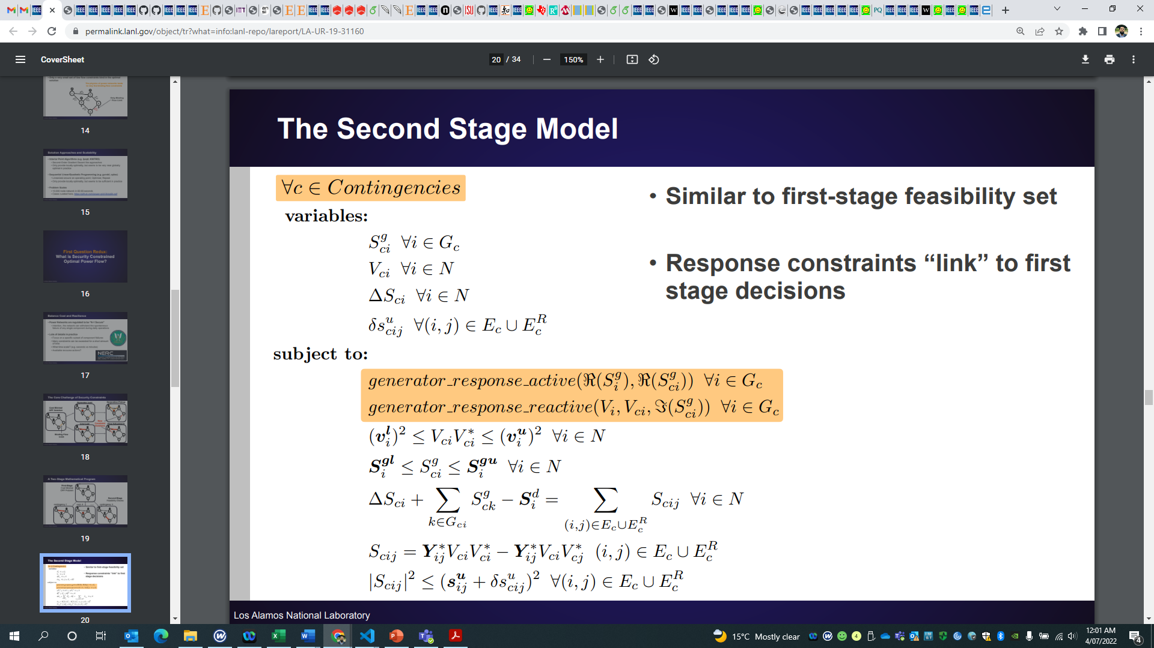
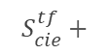
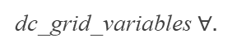
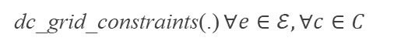
Second-Stage Formulation
Similar to first-stage feasibility set
Response constraints “link” to the first stage decisions
dc_grid_variables $∀.$
$$S_{cie}^{tf}+$$
dc_grid_constraints(.) $∀e∈ℰ,∀c∈C$

Slide 19
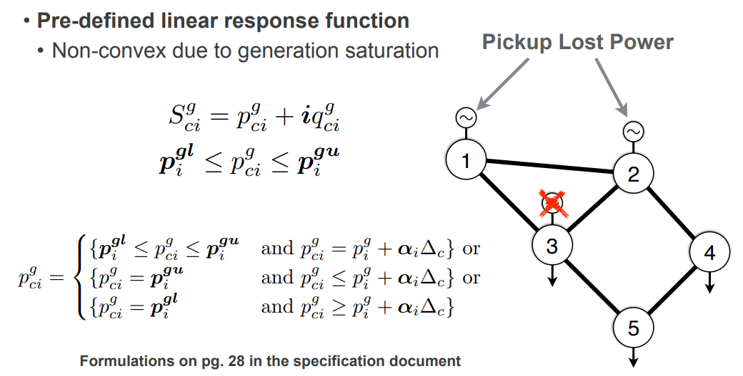
Second Stage Generator Active Power Response

Slide 20
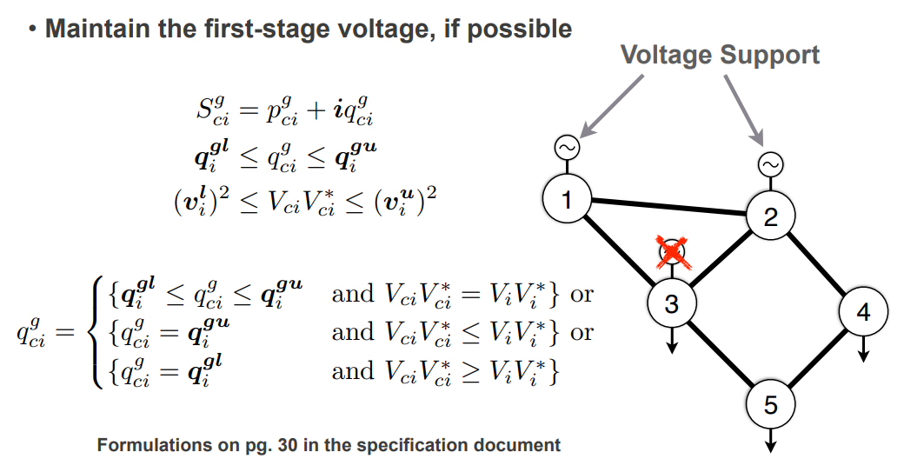
Second Stage Generator Reactive Power Response
→ Further relaxations (SOC, SDP, LP) are adopted from PowerModels.jl & powerModelsACDC.jl

Slide 21
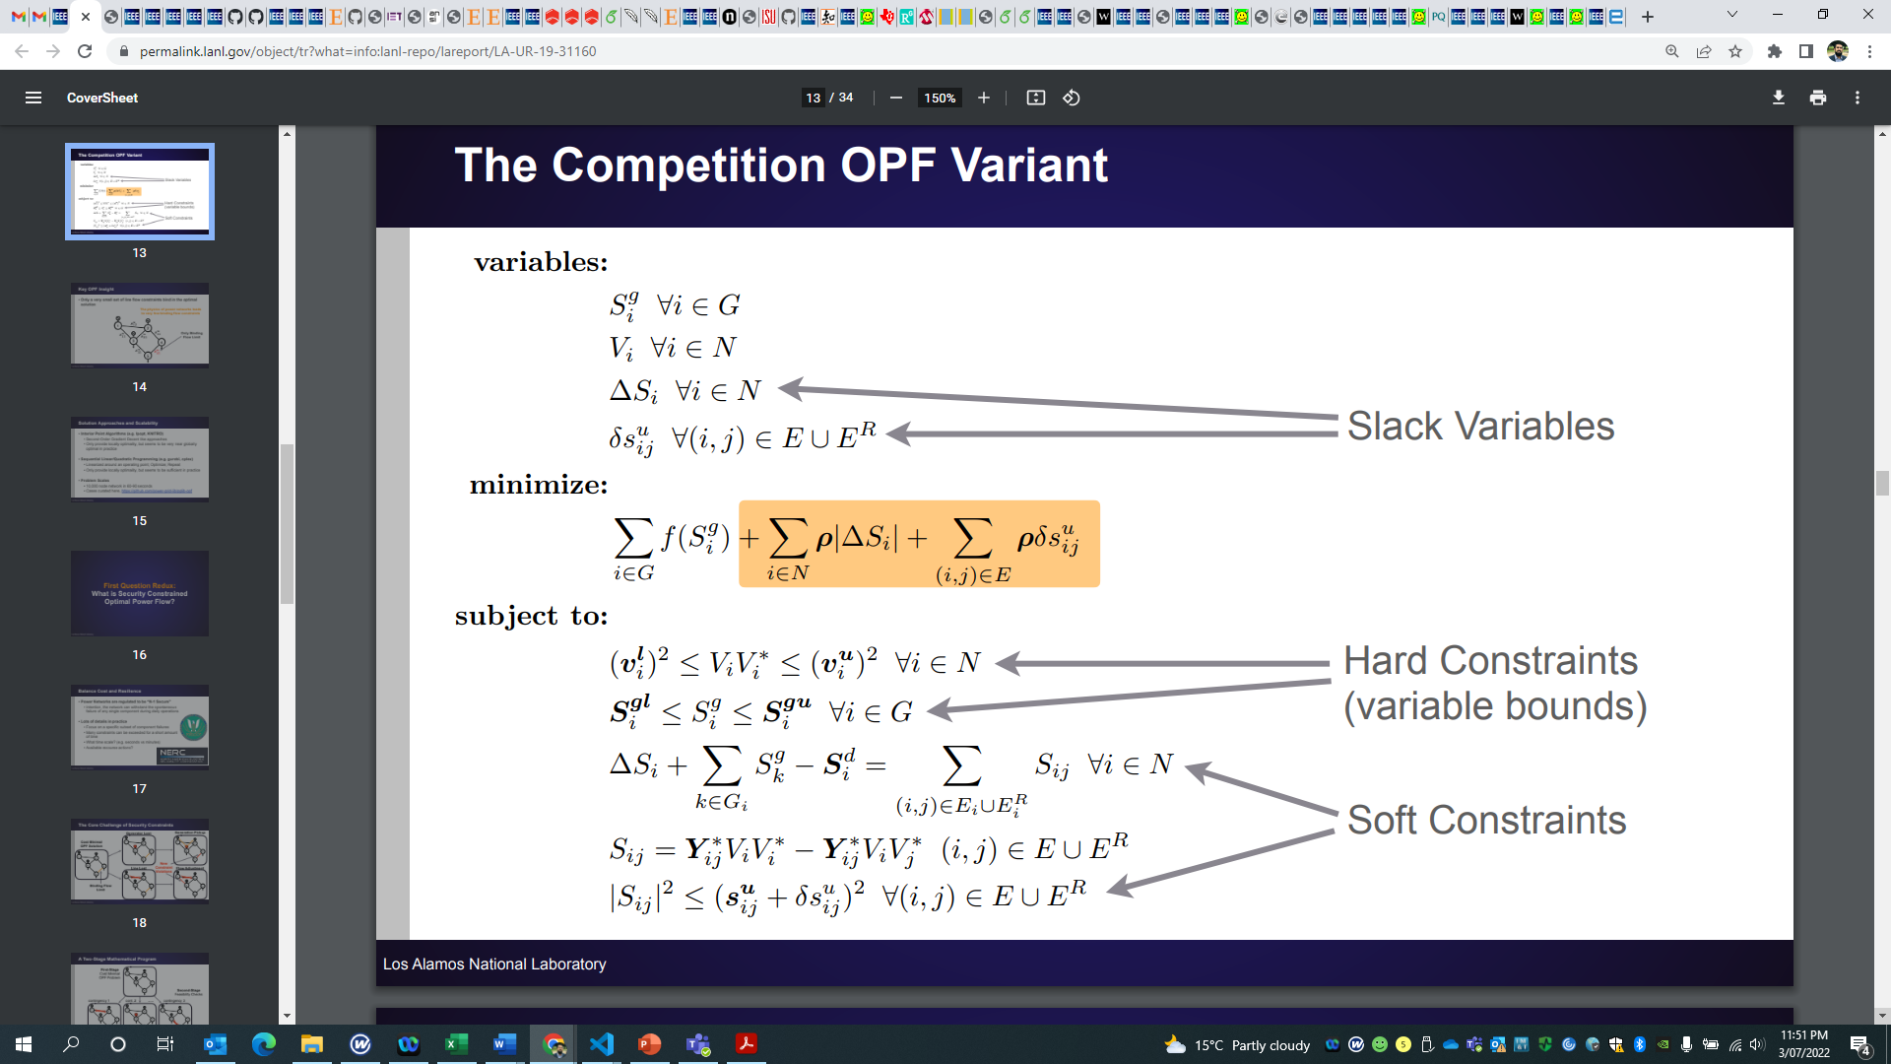
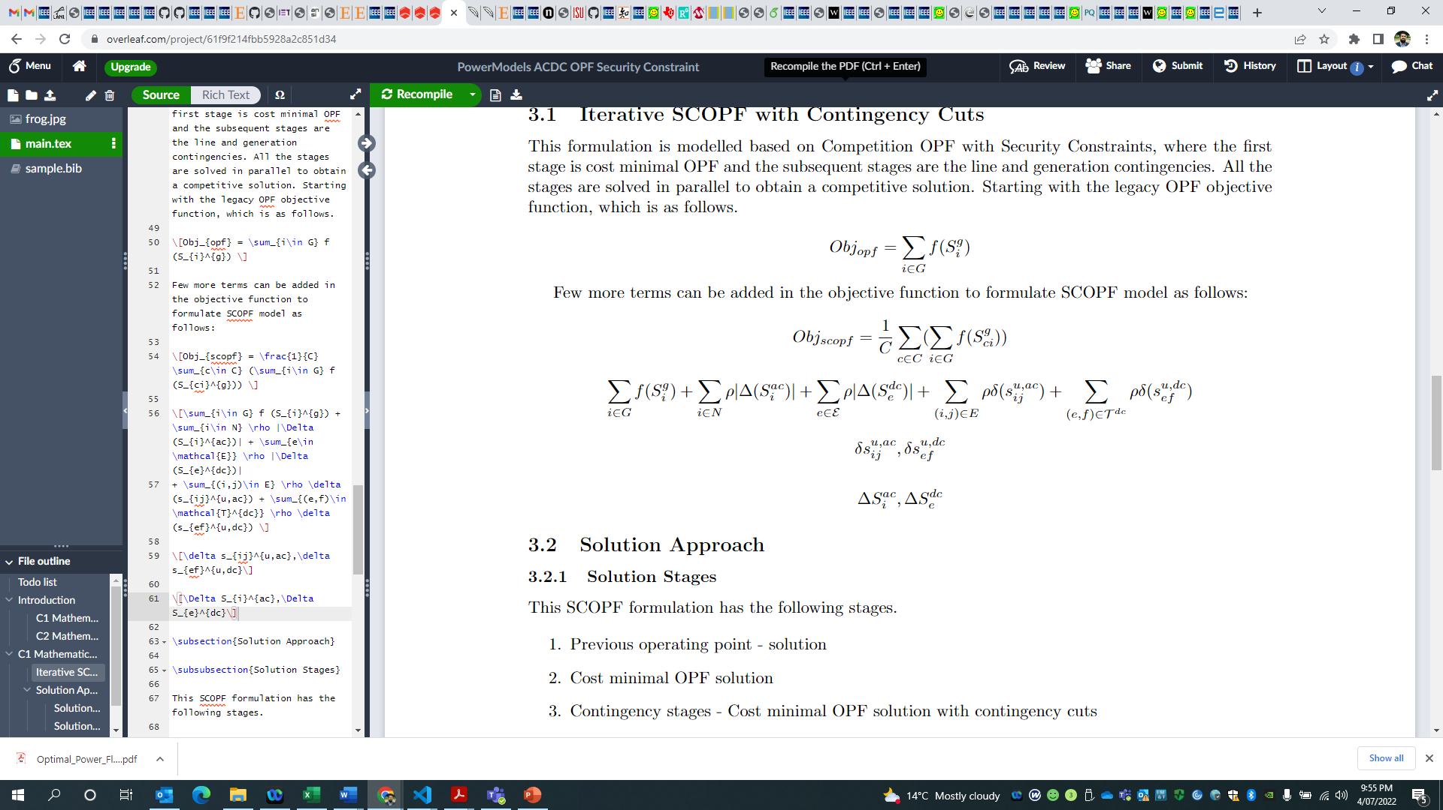
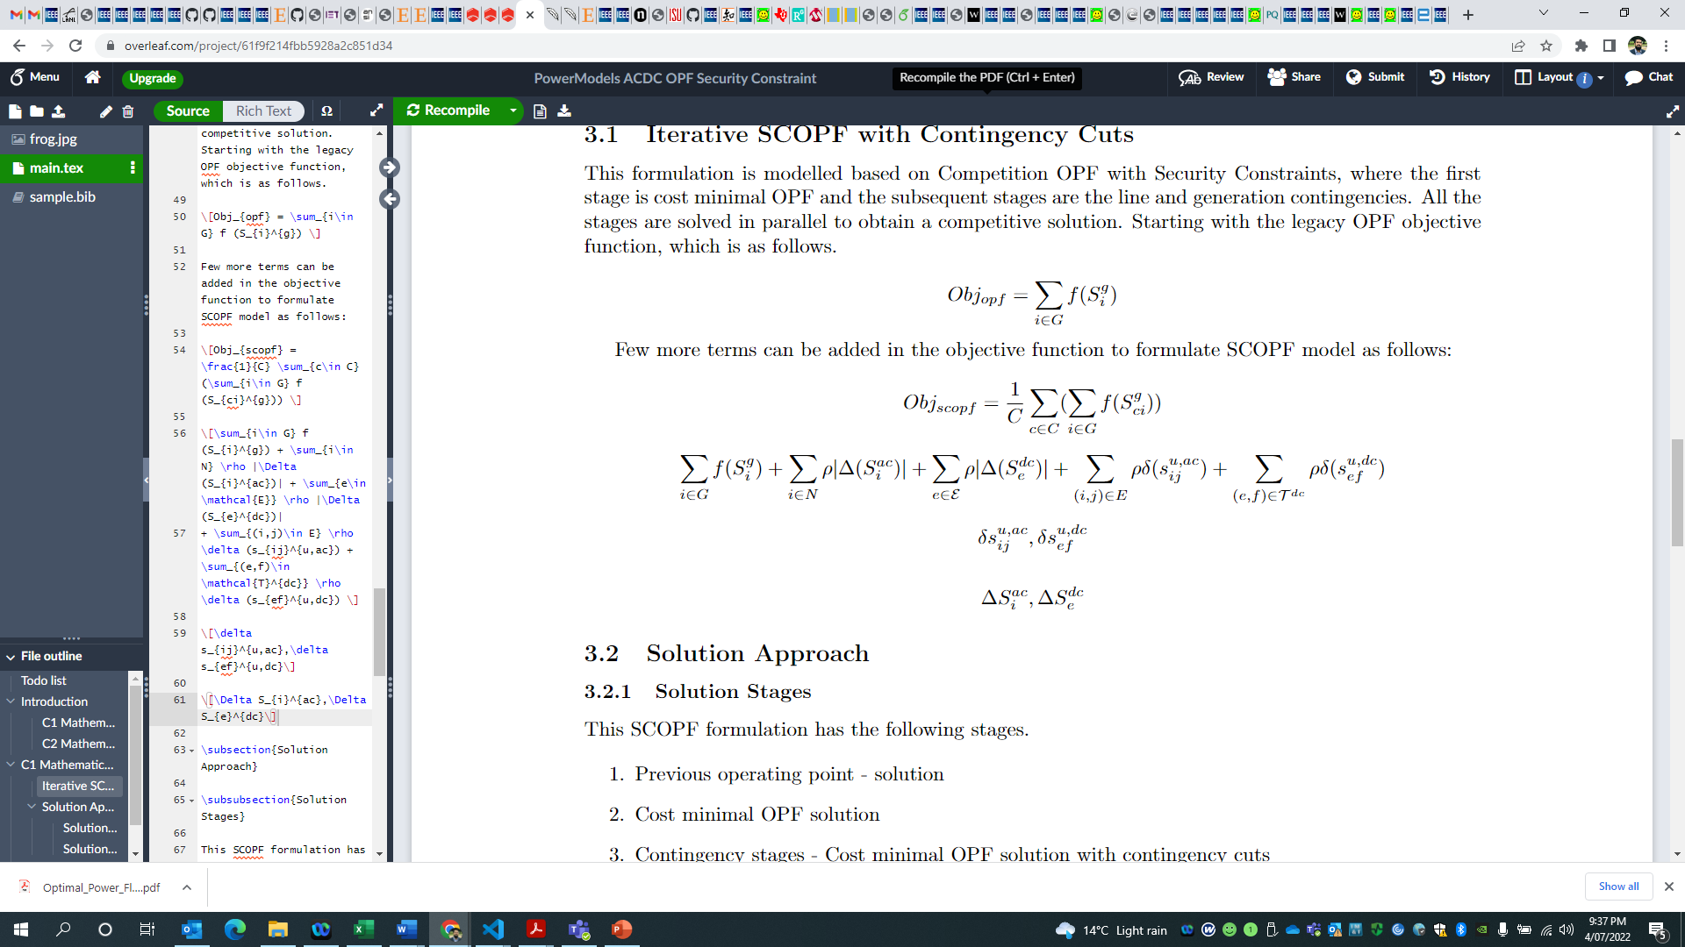
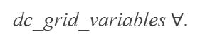
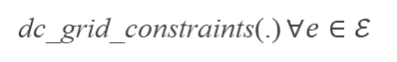
SCOPF – Soft Formulation – First-Stage
dc_grid_variables $∀.$
dc grid constraint slacks
$$S_{cie}^{tf}+$$
dc_grid_constraints(.) $∀e∈ℰ$

Slide 22
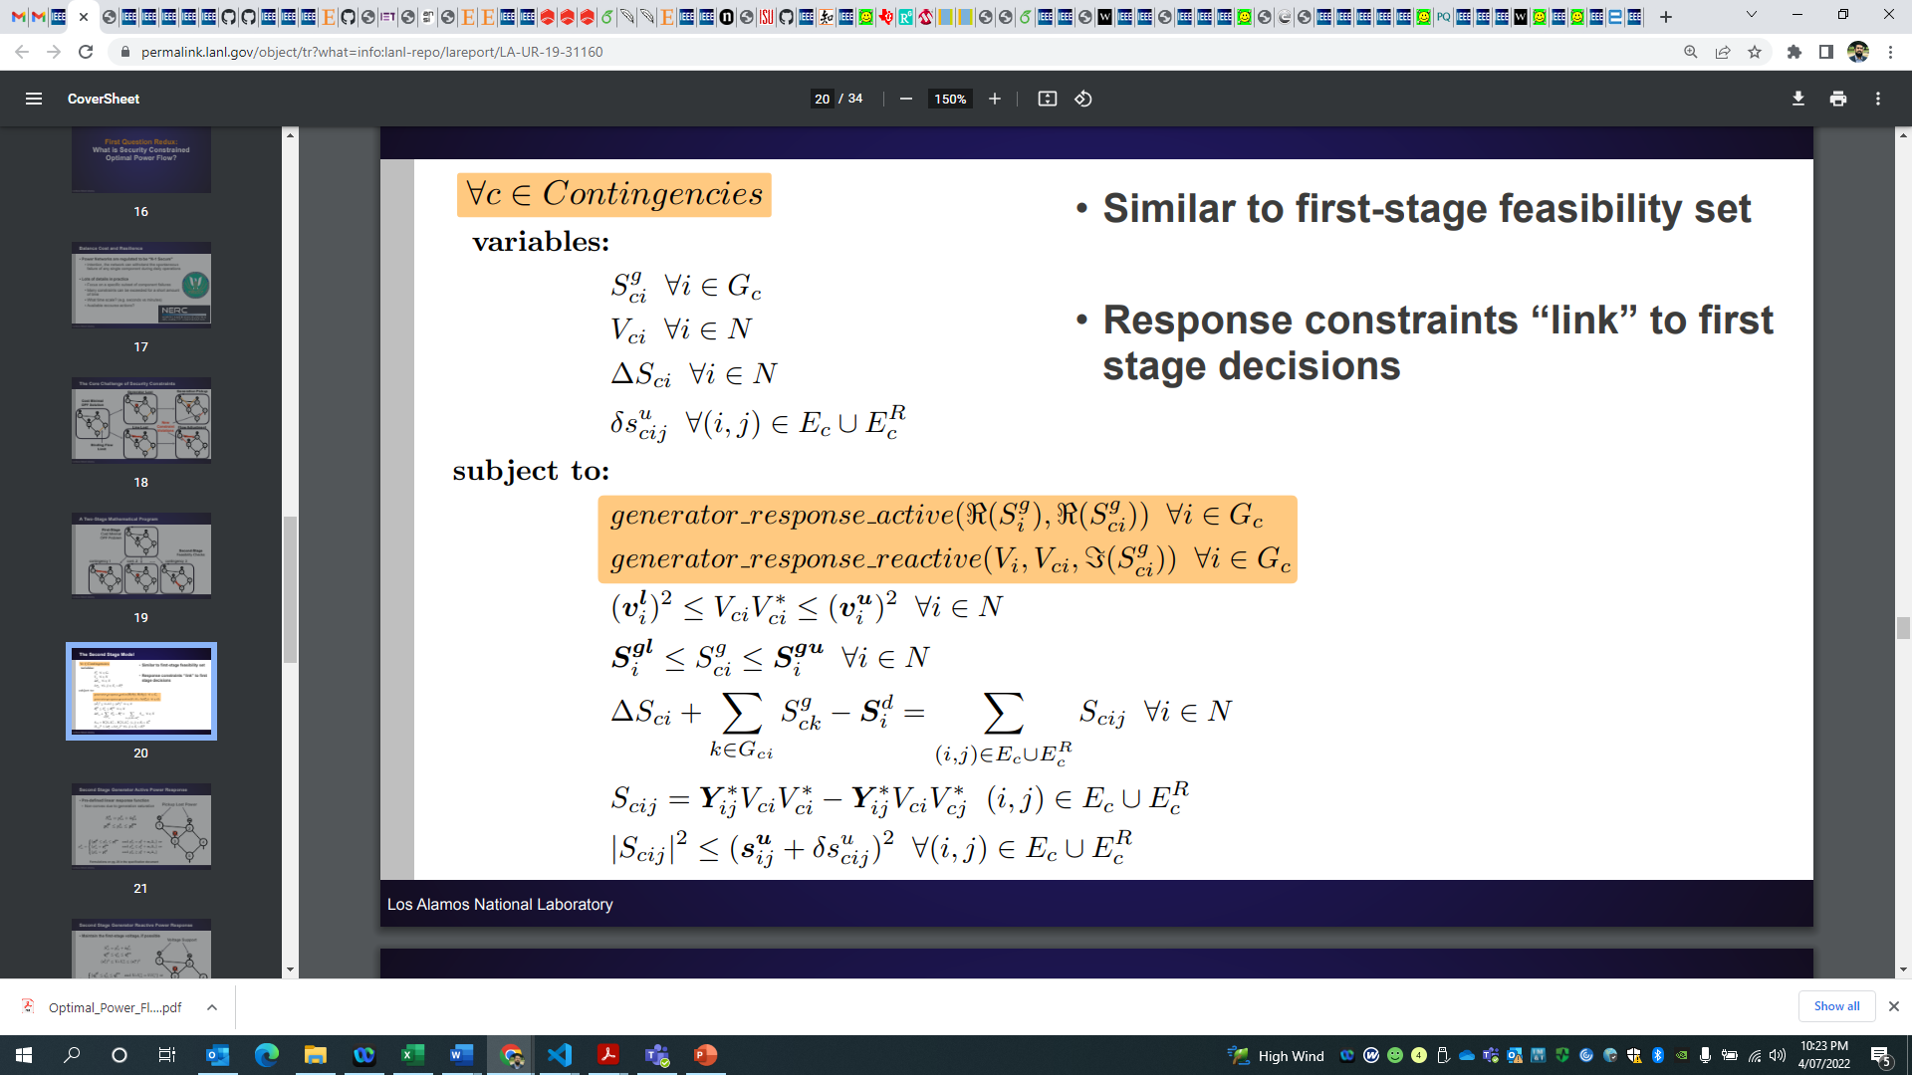
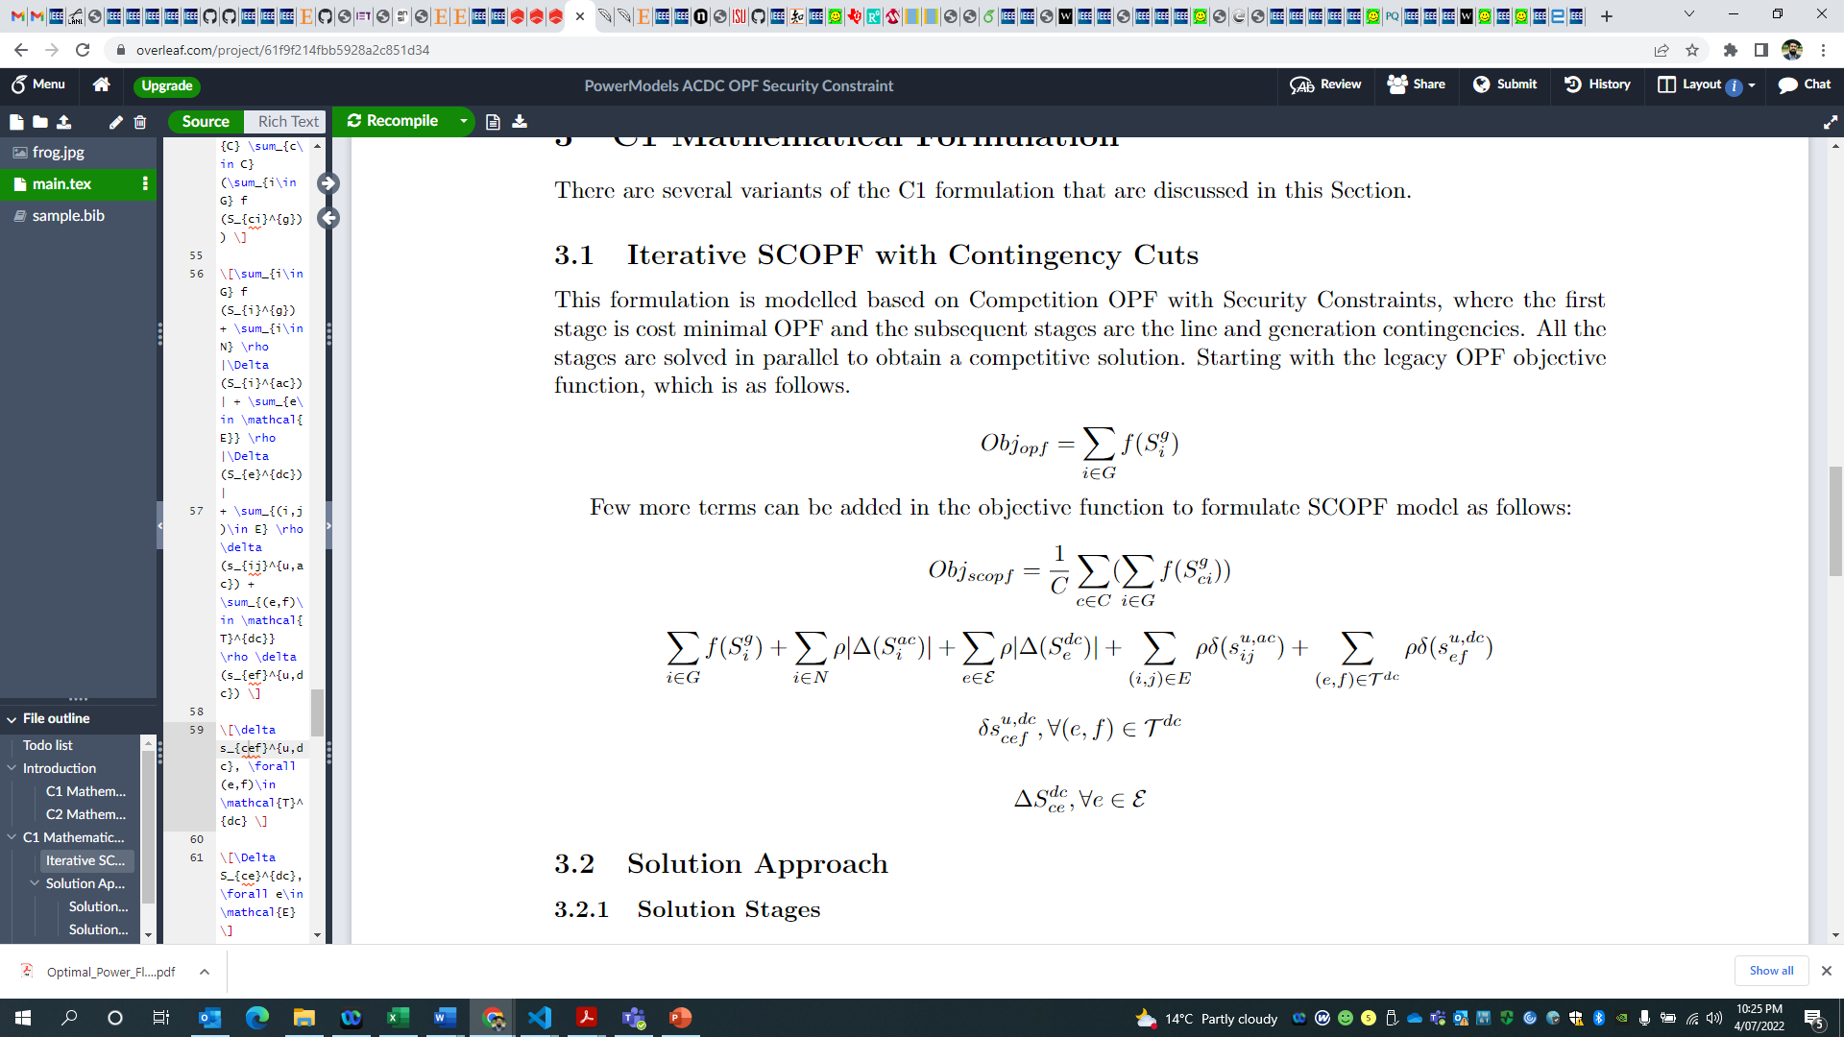
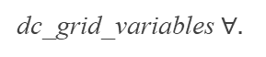

SCOPF – Soft Formulation – Second-Stage
dc_grid_variables $∀.$
$$S_{cie}^{tf}+$$
dc_grid_constraints(.) $∀e∈ℰ,∀c∈C$
→ Plenty of variations (PTDF, Linear Cuts) possible, working on the algorithm!

Slide 23
SCOPF – Robust Formulation
A bilevel max-min optimization model is proposed to find the worst contingency scenario while solving an ac optimal power flow problem considering corrective actions.
The overall objective is to minimize the total cost including generation and load shedding cost while satisfying all relevant constraints in the worst contingency scenario.
The upper-level problem allows representing contingencies (N-1 or N-2) using binary variables and maximizes the violations.
The lower-level problem solves ac optimal power flow problem considering corrective actions and minimizes the total cost.
This model can be solved using SOC approximations and duality theory.
→ Next formulation to work on!

Slide 24
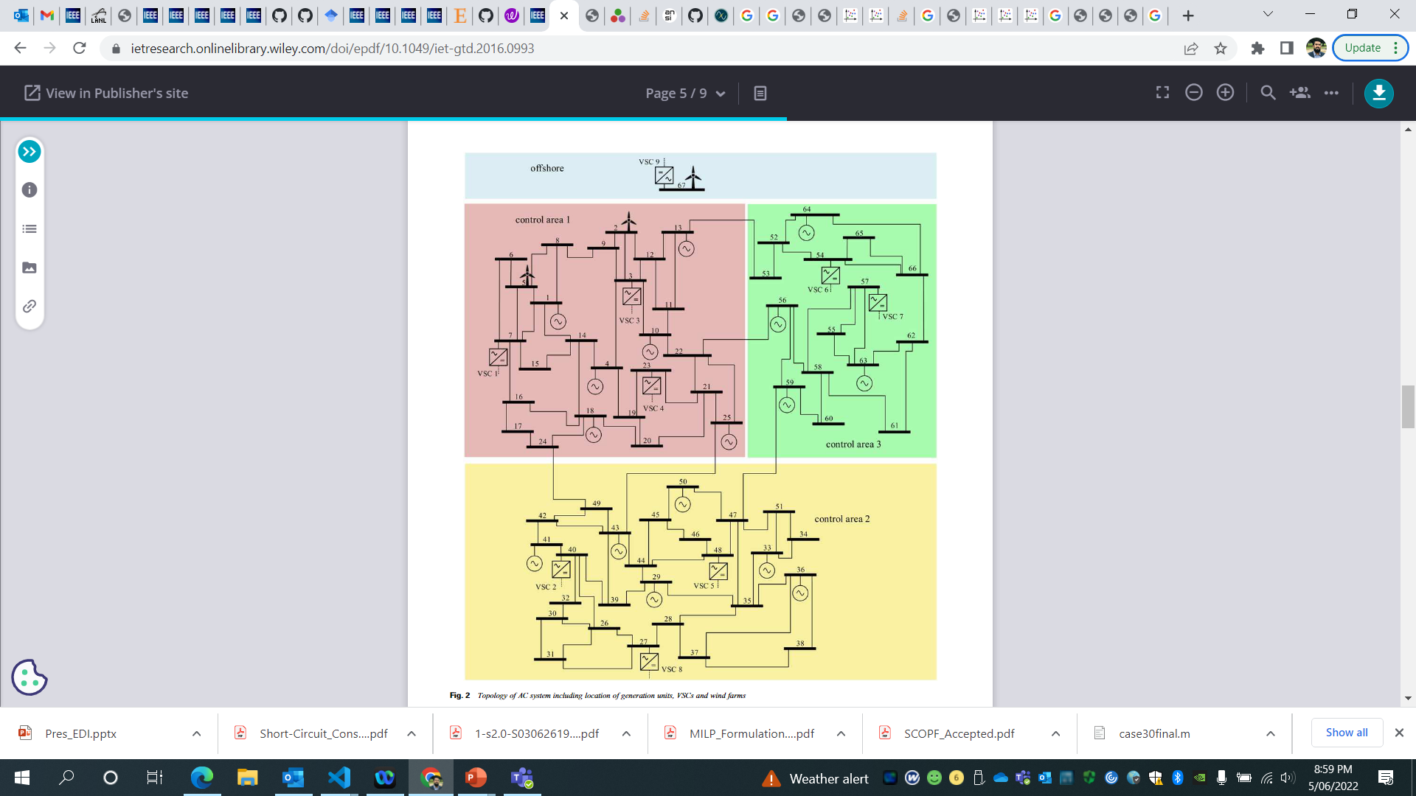
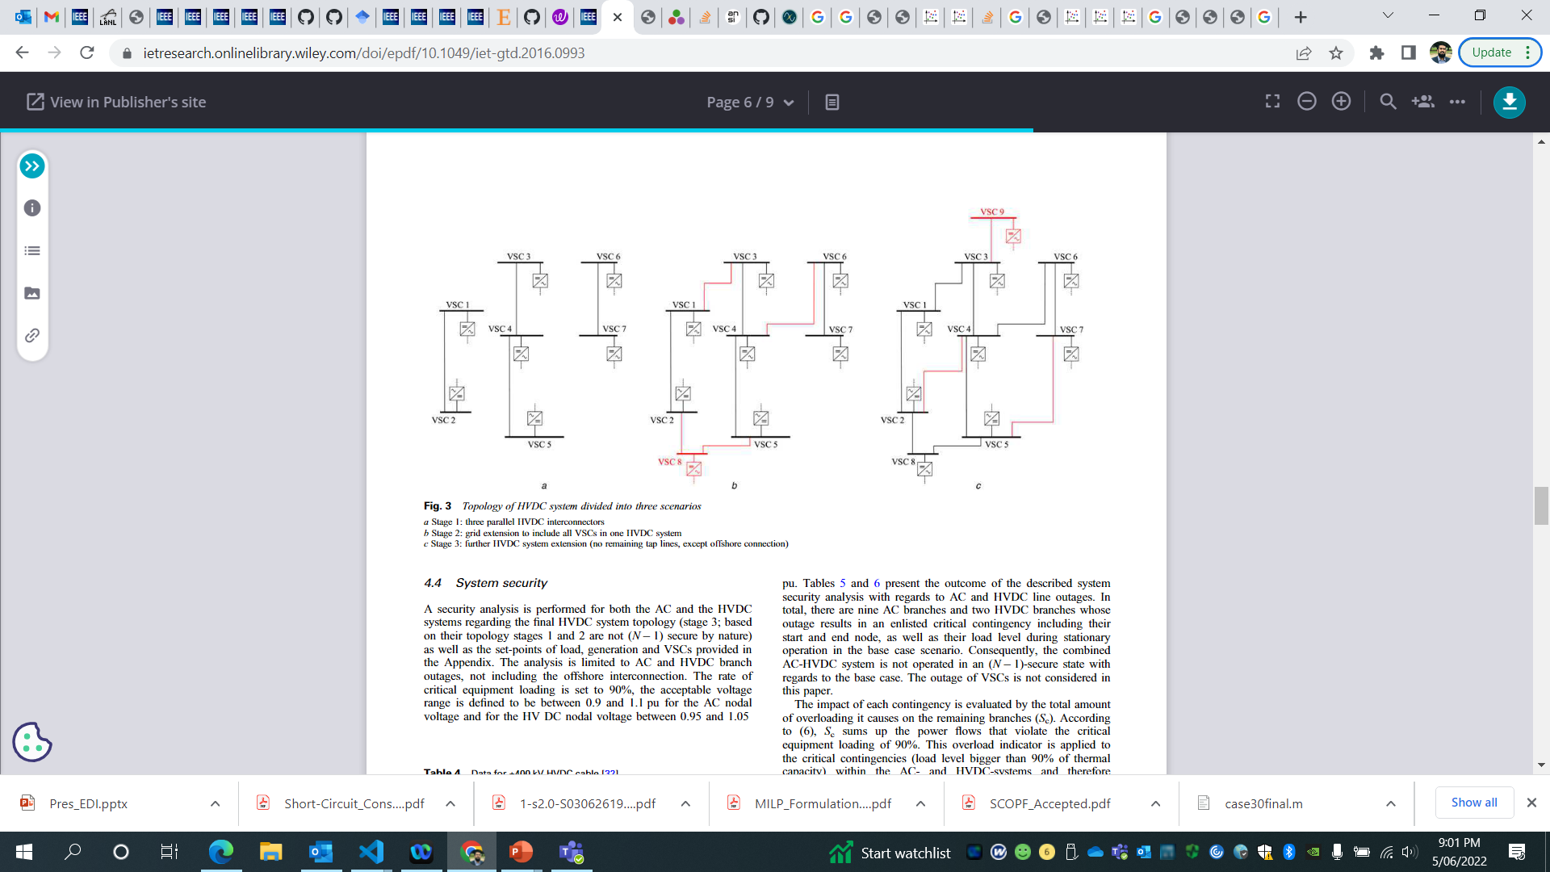
Benchmark Test Case
AC Grid
DC Grid
Grid Data:
AC Nodes: 67
AC Branches: 102
Transformers: 26
Converters: 9
HVDC Nodes: 9
HVDC Branches: 11
Syn Generators: 17
Wind Generators: 3
Contingencies:
AC Contingencies: 11
HVDC Contingencies: 2

Slide 25
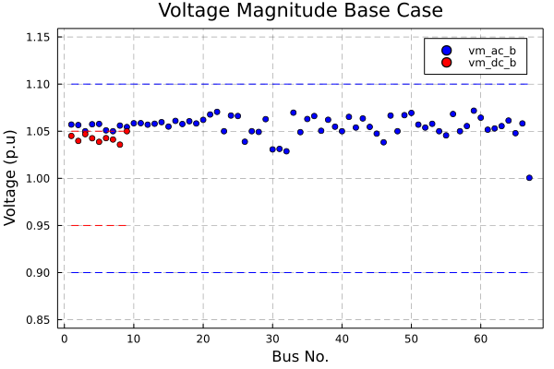
Results: Base Case

Slide 26
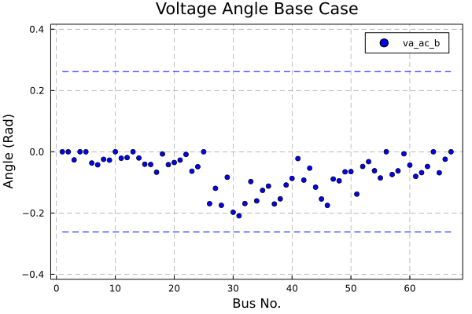
Results: Base Case

Slide 27
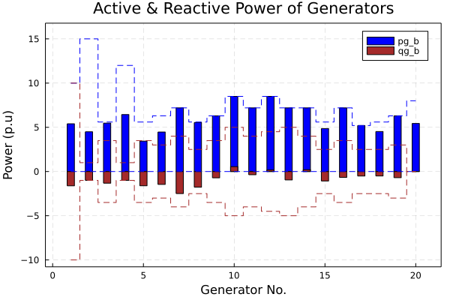
Results: Base Case

Slide 28
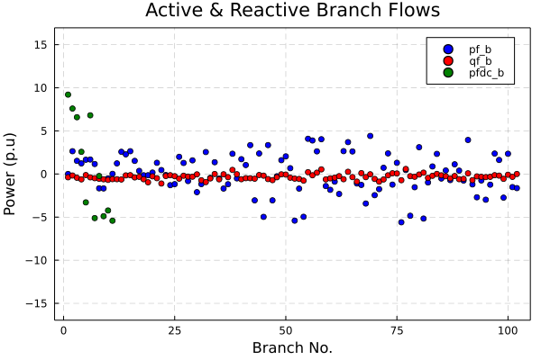
Results: Base Case

Slide 29
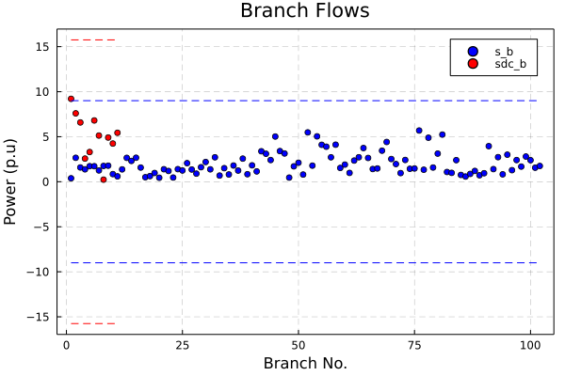
Results: Base Case

Slide 30
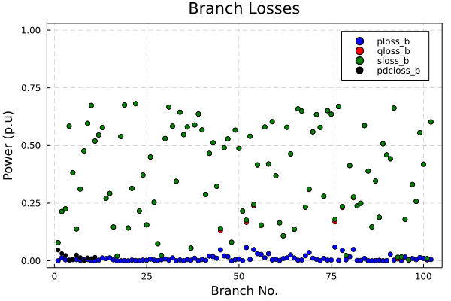
Results: Base Case

Slide 31
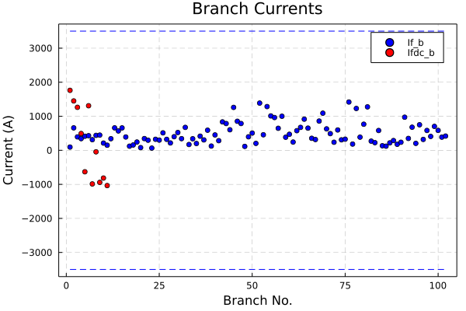
Results: Base Case

Slide 32
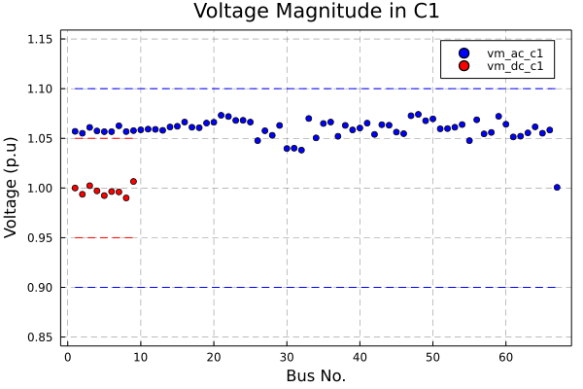
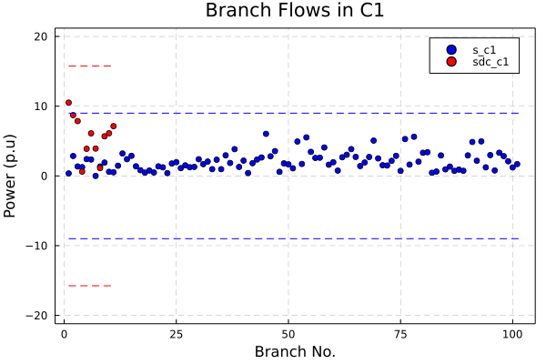
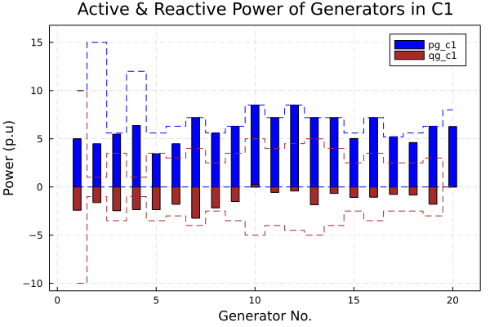
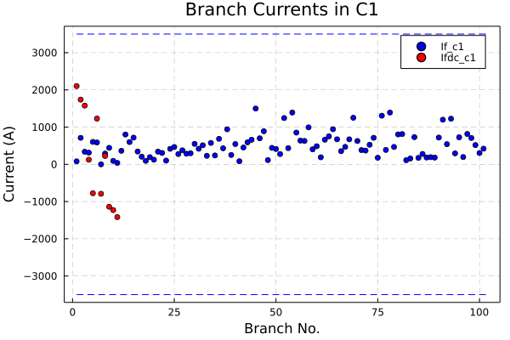
Results: Contingencies
C1

Slide 33
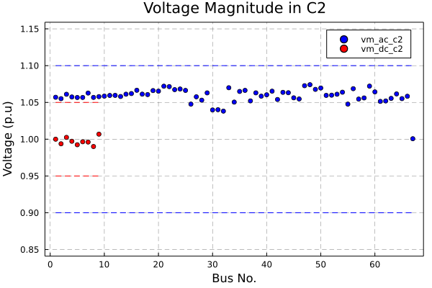
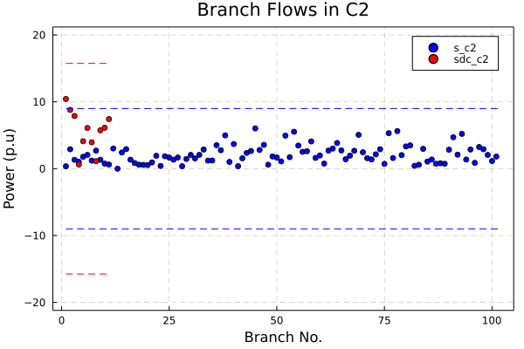

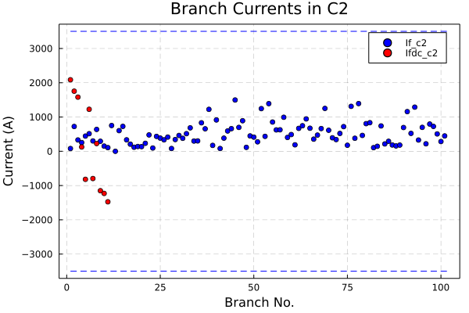
Results: Contingencies
C2

Slide 34

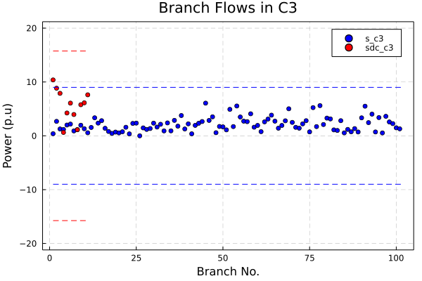
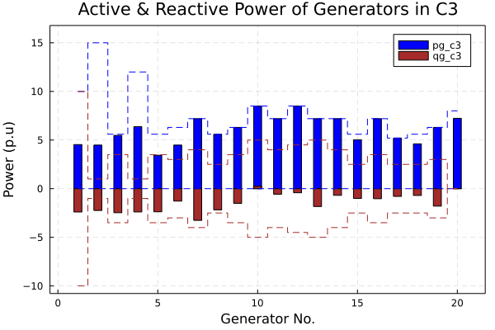
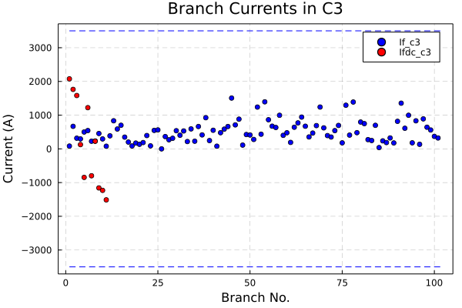
Results: Contingencies
C3

Slide 35
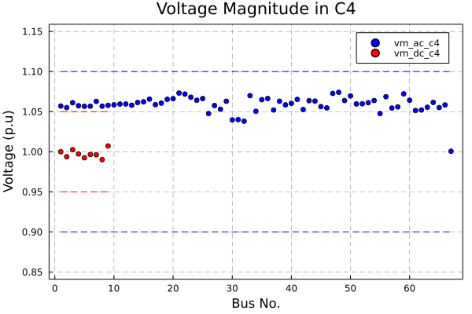

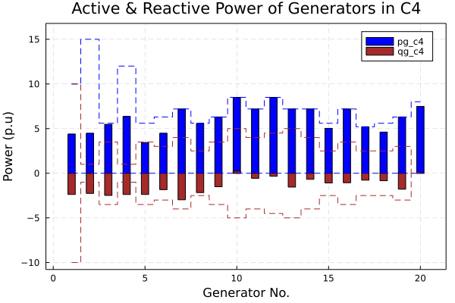

Results: Contingencies
C4

Slide 36



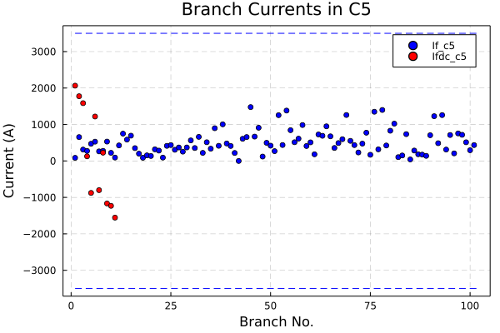
Results: Contingencies
C5

Slide 37
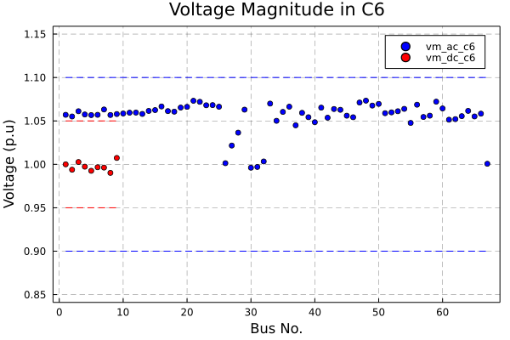
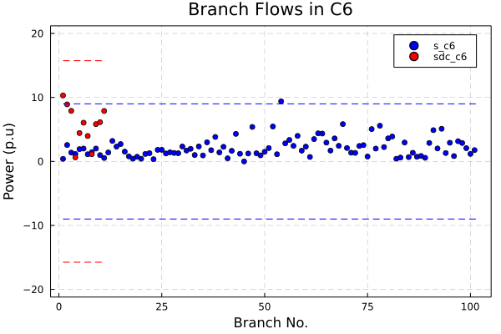


Results: Contingencies
C6

Slide 38




Results: Contingencies
C7

Slide 39




Results: Contingencies
C8

Slide 40




Results: Contingencies
C9

Slide 41




Results: Contingencies
C10

Slide 42




Results: Contingencies
C11

Slide 43




Results: Contingencies
C12

Slide 44




Results: Contingencies
C13

Slide 45

Results: Final Solution

Slide 46

Results: Final Solution

Slide 47

Results: Final Solution

Slide 48

Results: Final Solution

Slide 49

Results: Final Solution

Slide 50

Results: Final Solution

Slide 51

Results: Final Solution

Slide 52
Results: Cost and Losses
Base Case Cost: 65008.85599
Base Case losses: 38.34147224609092
Final Case Cost: 65096.57699
Final Case losses: 43.4649814388526

Slide 53
Thank You
Dr. Ghulam Mohy Ud Din
Ghulam Mohy Ud Din E:moh050@csiro.au
Thank you for your attention!

